Slide 1
From the Summit to the Grasslands:
Mapping national & institutional strategic planning goals
to student artifacts through ePortfolio assessment
Maggie Beers, Ph.D. Director, Academic Technology
Linda Buckley, Ph.D. Associate Vice President, Assessment & Planning
Gail G. Evans, Ph.D. Dean, Undergraduate Studies
ePortfolio Day of Dialogue
San Francisco, CA
February 25, 2009

Slide 2
Presentation Overview
Notes:
Welcome people for coming to the presentation
We are going to be talking today about the connection between strategic planning ,the Leap Outcomes, and ePortfolios as a way of aligning institutional goals with program and course objective and student competencies. We feel that this process helps institutions determine whether or not their strategic priorities have reached down to the level of the classroom.
We welcome your input and feedback, and we’re happy to answer your questions as we move through the presentation.
I’d like to take a moment to introduce my colleagues, Maggie Beers, the Director of Academic Technology at SF State and Gail Evans, the Dean of Undergraduate Studies at SF State. I am Linda Buckley, Associate Vice President for Academic Planning and Educational Effectiveness.
To get started, I’d like to take a moment to give you the overview of the presentation.

Slide 3
Presentation Overview
Notes:
Linda begins

Slide 4
LEAP Essential Learning Outcomes
Notes:
Linda gives brief reminder of LEAP outcomes

Slide 5
Presentation Overview
Notes:
Linda begins the section on CUSP strategic planning

Slide 6
SF State CUSP II Strategic Plan
Notes:
The SF State strategic plan was developed over a two year period with significant input from all constituency groups in the university. One of the intentional and unusual aspects of this strategic plan is that it was framed by objectives and expected outcomes, which makes the plan more easily assessed than most plans, which are typically aspirational narratives. In our assessment last year of Goal 1, Social Equity & Justice, we were able to find many institutional level activities that respond to this objective, such as faculty demonstrating how this goal was being realized as student competencies. This year we realized that one of the unintended, but positive aspects of the plan is that it maps well onto the LEAP outcomes, which are expressed as student learning outcomes. Today we’re going to show you through an example of the Social Justice & Equity goal how that mapping and the use of ePortfolios can help campuses align their strategic priorities with student competencies and the assusrance of learning.

Slide 7
Presentation Overview
Notes:
Gail begins her section on baccalaureate and undergraduate outcomes

Slide 8
Executive Order for General Education
TO: California State University
FROM: CSU Chancellor Reed
Re: General Education & LEAP
Date: June, 2008
“Each CSU campus shall define its GE student learning outcomes to fit within the framework of the four ‘Essential Learning Outcomes’ drawn for the LEAP campaign, an initiative of the Association of American Colleges and Universities.”
Notes:
(Start here)
In June 2008, the Chancellor of the California State University System issued a new Executive Order for the governance of General Education. The incorporation of the LEAP Outcomes into this Executive Order gave those of us who were “revisioning” general education a wonderful foundation on which to build our undergraduate degrees to meet the needs of students in the 21st Century.

Slide 9
San Francisco State’s Baccalaureate Goals
SF State undergraduates will emerge from their studies with a breadth and depth of knowledge and understanding developed from integrating their course work and academic experiences in both general education and in the major…
We expect the following interconnected educational outcomes from a baccalaureate of SF State:
Notes:
(Start Here)
Following an external review of the General Education Curriculum, which has been in place since 1981, the Academic Senate at SF State constituted The Graduation Requirements Task Force to review and “rethink” all of the baccalaureate degree requirements. The Task Force has spent the past three years researching best practices in undergraduate education. This research has included evaluating curricula and programs from other institutions, consulting with experts on General Education revisions, and reviewing publications by AAC&U, including the LEAP publications. The Baccalaureate Goals that were approved by the Academic Senate in March, 2008 show clear linkage to the LEAP Essential Learning Outcomes.

Slide 10
San Francisco State’s Baccalaureate Goals
Notes:
(Start Here)
So the six baccalaureate goals for all undergraduate students at SF State are:
(Go to slide)

Slide 11
San Francisco State’s Baccalaureate Goals
=LEAP #2
Notes:
(Start Here)
The first SF State baccalaureate goal is Competencies for Lifelong Intellectual Endeavor, which embodies the 2nd LEAP Outcome of Intellectual and Practical Skills. The full text of the goal is “Graduates will be competent in critical questioning and analysis, creative and independent thought, attentive reading and interpretation, written and other forms of communication, quantitative reasoning, research drawing upon a variety of resources, problem solving, and collaboration. Students should have knowledge of a language other than English.”

Slide 12
San Francisco State’s Baccalaureate Goals
Intellectual Attainments
Goal 2
=LEAP #1
Notes:
The first LEAP Outcome is Knowledge of Human Cultures and the Physical and Natural World. SF State’s 2nd goal includes, “Graduates will be conversant with the principal domains of knowledge associated with liberal learning: the sciences and mathematics, the social sciences, the humanities, and the arts. They will be able to apply the modes of inquiry associated with these domains and will have engaged questions and issues of enduring importance. They will also gain in-depth knowledge and understanding of at least one major course of study. These competencies and attainments will provide graduates with intellectual foundations for careers or for advanced study.” As you can see, this goal incorporates both general education and the major.

Slide 13
San Francisco State’s Baccalaureate Goals
Appreciation for Diversity
Goal 3
=LEAP #3
Notes:
The third LEAP Outcome of Personal and Social Responsibility is at the very core of everything we do at SF State, beginning with the Mission statement. We are one of the most diverse campuses in the country, with one of the largest populations of international students. Our goal of Appreciation of Diversity states , “Graduates will know, understand, and appreciate multiple forms and variations of human diversity, both within the United States and globally. Graduates will respect themselves and others. They will have obtained a historical perspective about the development of our diverse nation and will be able to engage in informed, civil discourse with persons different from themselves in intellectual and cultural outlook.”

Slide 14
San Francisco State’s Baccalaureate Goals
Ethical Engagement
Goal 4
=LEAP #3
Notes:
LEAP’s 3rd Outcome also encompasses ethical reasoning and action. We have incorporated that in our 4th baccalaureate goal that states, in part, “Graduates will have an appreciation of the necessity and difficulty of making ethical choices, both private and public, and will be able to identify and analyze the values that inform those choices.. Graduates will recognize their responsibility to work toward social justice and equity by contributing purposefully to the well-being of their local communities, their nations, and the people of the world, as well as to the sustainability of the natural environment.”

Slide 15
San Francisco State’s Baccalaureate Goals
Integration & Application of Knowledge
Goal 5
=LEAP #4
Notes:
The fourth LEAP Outcome is Integrative Learning. Our goal states that graduates will know how to make connections among apparently disparate forms of knowledge and modes of inquiry across academic disciplines and between the principal domains of knowledge and their majors. They also will be able to place such knowledge and approaches within their cultural, historical, and sociopolitical contexts. Graduates will be able to apply academic knowledge to what is important in their own lives and to local and global communities.

Slide 16
San Francisco State’s Baccalaureate Goals
Qualities of Mind & Spirit
Goal 6
=LEAP #1,2,3,4
Notes:
Our 6th baccalaureate goal truly embodies all four LEAP Outcomes in preparing our students for the global, 21st century. Graduates will take with them dispositions that facilitate lifelong learning and growth, including curiosity, a sense of wonder, intellectual flexibility and adaptability, a refusal to simplify what is inherently complex and ambiguous, a sense of responsibility and accountability, critical self-reflection, independence of mind, respect for wellness and healthy living, a readiness to assume leadership roles, and reverence for all that unites us as human beings across time.

Slide 17
Physical Science Learning Outcomes
After completion of a lower division course in physical science, students will be able to:
Notes:
In developing the new general education curriculum, the Task Force members have incorporated a student learning objective that relates directly to each of the six baccalaureate goals, for all of the general education areas (e.g. humanities and arts, physical and life science, social sciences). You will notice on the right of the slide the 6 bacc. goals that I’ve just described, and how they are “mapped” to the specific learning outcomes for physical science. In this way, we will be able to easily obtain both program and course-embedded assessment of student learning.
So I hope this gives you an example of how the LEAP Outcomes can be used to facilitate and enhance curricular development, and how you might be able to get “all your ducks in a row!” And now it’s my pleasure to introduce Maggie Beers, who will talk about incorporating ePortfolios into the assessment process with the overall LEAP vision.

Slide 18
Presentation Overview
Notes:
Maggie begins section on ePortfolios

Slide 19
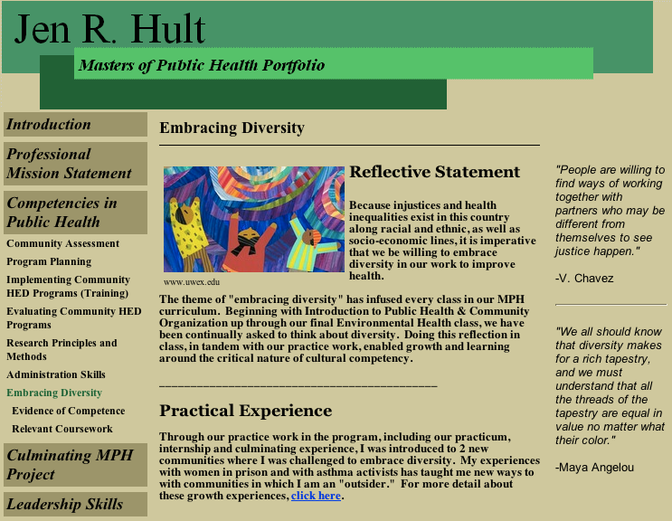
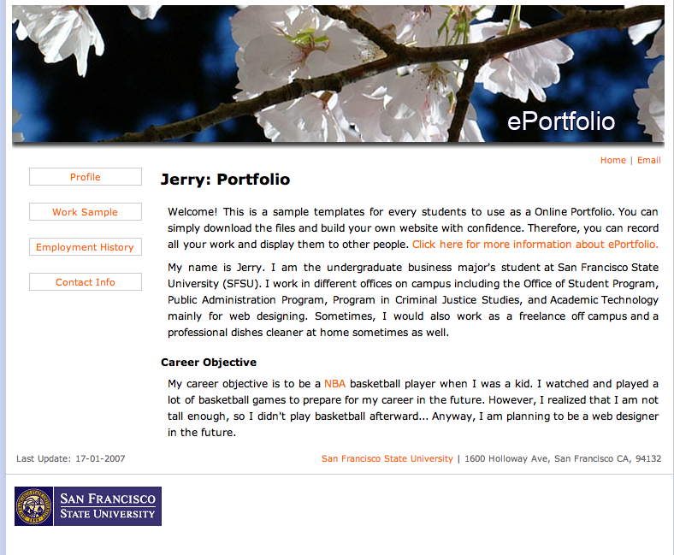
What is an ePortfolio?
Paper-based Portfolios
Electronic Portfolios
Notes:
The concept, and intended use, of portfolios in higher education are not new. Many universities have long been using some form of paper-based portfolios to assess student work or to use for academic program review. What has changed now is that there is a globally growing need to migrate from paper-based portfolios to electronic portfolios. Electronic Portfolios can be thought of from both a technical, and pedagogical perspective: on the one hand ePortfolios are a technology, a virtual space in which students can archive their artifacts from their academic, personal and professional life and post their reflections for sharing. On the other hand, ePortfolios are teaching methodology--a holistic, integrative, process-based approach to assessment in which students can demonstrate, to selected audiences, their life-long learning, skills, and development over time.

Slide 20
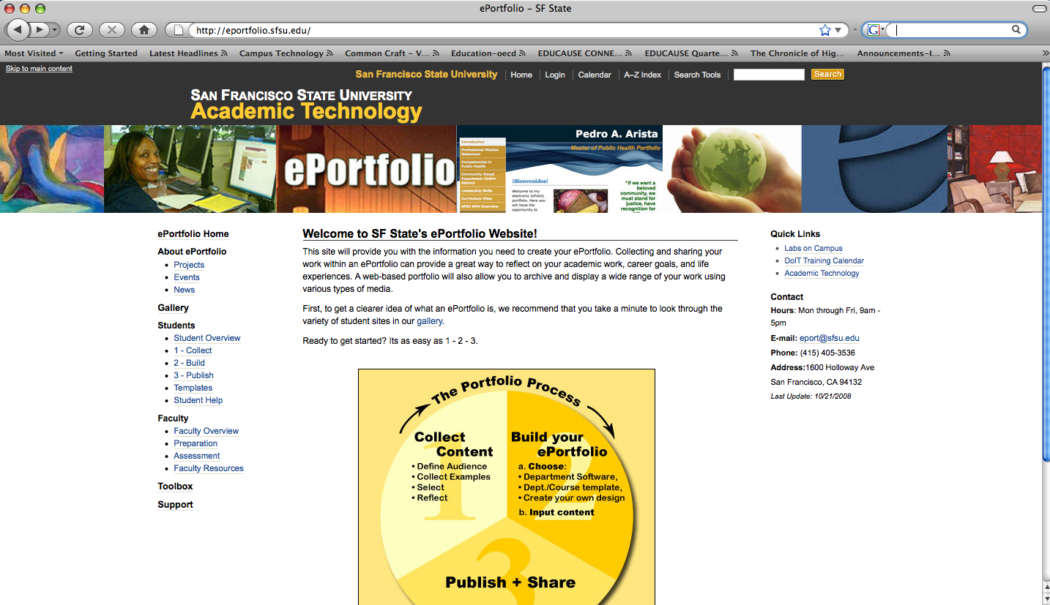
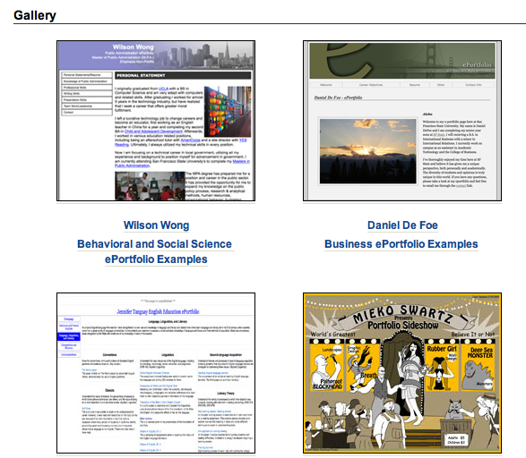
ePortfolio.sfsu.edu
Dr. Ruth Cox
SF State ePortfolio Lead
& Kevin Kelly
Online Teaching & Learning
GALLERY of Examples
Notes:
20
San Francisco State is becoming more known as a leader in the use of ePortfolios in post-secondary education, largely attributed to the work of Dr. Ruth Cox who is heading up our ePortfolio initiatives, as well as Kevin Kelly, Online Learning and Teaching Coordinator. SF State has been designated the ePortfolio Center of Excellence in the California State University system, and has also been selected by the AAC&U to participate in its VALUE grant that is evaluating ePortfolio assessment rubrics. Please visit our ePortfolio website that has a variety of resources for students and faculty and also a large gallery of examples of model ePortfolios.
-----------
ePorfolios address a current and emerging need for students, faculty and institutions to have an environment in which they can collect, select, reflect upon, build, and publish a digital archive of their work. As you’ll see in the gallery of examples on our ePortfolio website, there are several types of ePortfolios and they serve serve multiple purposes within the SF State academic setting.
I’ll briefly describe the different types, moving from an individual to a collective level of ePortfolios:
Students can create individual, personal ePortfolios to showcase their achievements and receive feedback and assessment from faculty, peers, potential employers or graduate programs.
Faculty members can also create personal ePortfolios to showcase their research and teaching interests and accomplishments. Faculty can also create a course ePortfolio, such as in the example I will show later, to gather and showcase the collective work of a group of students long after the course has finished.
-Finally, universities can create institutional ePortfolios to collect student work and assessment data for accreditation purposes or recruitment of future students. Since ePortfolios are becoming more commonplace in the K-12 and Community College systems, they can also be used by feeder institutions from within California to assist with student transfer to SF State.
-------

Slide 21
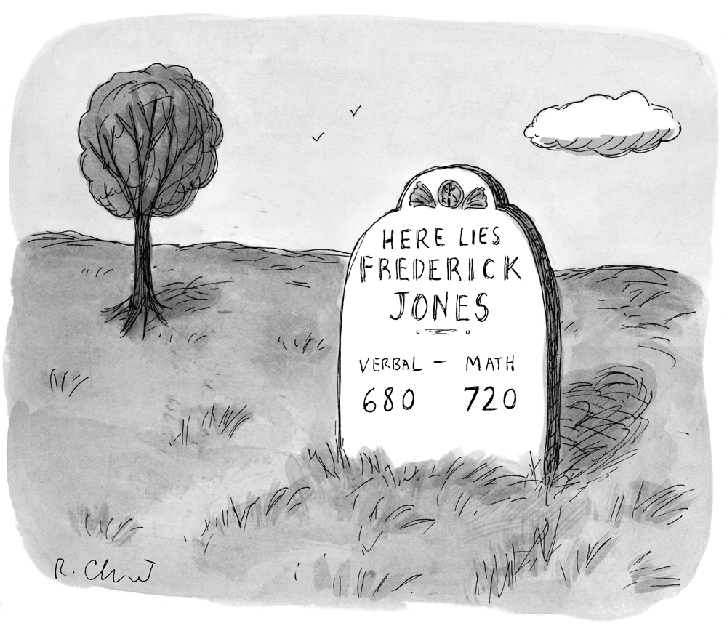
Why ePortfolios at SF State?
Notes:
Why ePortfolios at SF State? The reason is our students. “Verbal 680 and Math 720” is not the way we want to remember the rich achievements of Frederick Jones, one-time undergraduate student, life long learner, and global citizen. ePortfolios provide a more holistic approach to foster and honor the achievements of our students.

Slide 22
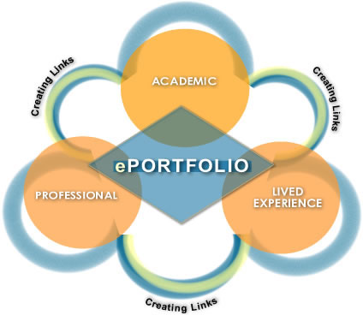
What is an ePortfolio?
Intentional &
Integrated Learning
Credit: La Guardia C. College
Notes:
In the report, “College Learning for the New Global Century,” written by the National Leadership council for LEAP, there is a call for educators to help students become “intentional learners” who focus on achieving the essential learning outcomes across ascending levels of study and diverse academic programs. But to help students do this, they say, educational communities will also have to become far more intentional themselves-both about the kinds of learning students need, and about effective educational practices that help students learn to integrate and apply their learning. (p. 4).
As the LEAP report reminds us, we all share in a common obligation to prepare our graduates as fully as possible for the real-world demands of work, citizenship, and life in a complex and fast-changing society. In today’s digital society, where students don’t always follow a standard path to undergraduate education, and where learning occurs in a variety of informal and formal learning environments, ePortfolios enable our students to demonstrate their learning accomplishments in their academic, professional, and lived experience. What’s more, ePortfolios prompt the students to make explicit, through reflective postings, the links that occur between these different types of learning experiences, as well as between the different fields of study.
Another advantage of the ePortfolio experience is that students use multiple forms of digital media---audio, video, text, and images--- to create representations of their learning. This helps them develop what are called digital literacies, or multiliteracies, that are so important to be successful in today’s society. Students are faced with so much information, many say it is more important to understand the links between the information, than the information itself.
LEAP=Liberal Education & America’s Promise
-----
Students can demonstrate integrated learning by providing ePortfolio pieces related to internships, jobs, or other co-curricular work. Reflective statements should demonstrate students' understanding of the links between delivered curriculum, or what the instructor prepares and presents; experienced curriculum, or what the student derives from it; and lived curriculum, or what the student applies throughout his or her life alongside or after the coursework (Yancey, 2008).

Slide 23
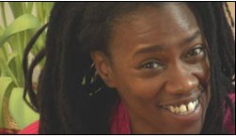
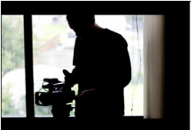
Mapping Artifacts to Institutional Goals
Electronic Portfolio
Video
Reflection
Texts & Resources
Notes:
I mentioned before that there are instances of individual ePortfolios, course ePortfolios, and institutional ePortfolios, and In this next part of the presentation I will pull a sample from the middle of that continuum-an SF State course ePortfolio from the course, “Health and Social Justice Documentary Films”. In a moment I will share artifacts that the students contributed to this course ePortfolio, as well as their reflections, and show how these artifacts are able to demonstrate not only that the students enrolled in this course have met the main course learning outcome, but also the Undergraduate and LEAP outcomes that Gail and Linda have just presented. I will be using the LEAP example of Personal & Social Responsibility.

Slide 24
SF State Course
Instructor:
Rachel Poulain
Students:
Cinema
Health Education
Sociology
Urban, Ethnic, and Women's Studies
Course Learning Outcome:
Students will be able to shoot and produce a documentary
on a Health & Social Justice Issue
http://documentaryforhealth.sfsu.efolioworld.com/index.asp?Type=&SEC=
Notes:
Before we dive too deep, here is some background on this course. This course was sponsored by the Center for Health Equities at San Francisco State, where Dr. Cynthia Gomez is the Director, and AIDNET, a national organization dedicated to raising awareness about HIV and AIDS. The instructor, Rachel Poulain, is a very engaged graduate from our master’s program in Health Education, and an accomplished ePortfolio creator. The students are undergraduates, from the departments of Cinema, Health Ed, Sociology and Urban, Ethnic, and Women’s Studies. Although there were other learning outcomes as well, for the purpose of simplicity, this is the main learning outcome that we will map today. Students worked in teams of 3-4 and traveled to New Orleans, Oklahoma, and other urban areas to film stories of women living with HIV.

Slide 25
Notes:
If we look closely at the Course ePortfolio navigation bar on the left, you will see that there is a home section which provides the background context for the project, and there are a series of modules centered around the finished documentaries with titles such as, “Be nice to Sex Workers,” “Empowering the Yard,” Living Positive, Pasa La Voz, etc. Within each module, is the backgound on the documentary, an explanation of community partners, the documentary itself, personal bios of the film makers and their reflections on their learning, and resources for the community. This course ePortfolio serves as both a repository for the work these students have done, a testimonial to their learning, and a community resource for further education on women and HIV.

Slide 26
Mapping Institutional Goals to Artifacts
Video
Reflection
Texts & Resources
Notes:
Given the different levels of communication, outreach, and demonstrated learning that are represented in this course ePortfolio, it is fairly easy to start at the granular level of the artifacts and work our way back up the chain to the highest level of LEAP outcomes to prove that the students in this course have met each of these. Using the example of Social Justice, I will show you some of these artifacts, and I think you will see that these documentaries and reflections demonstrate achievement of outcomes from the course, department, baccalaureate goals, strategic university goals, and LEAP outcomes.
Although students must complete all the requirements for a class or program, it is also important for them to reflect on why they are doing a specific assignment, and how it relates to the class, the program, or their life goals. They can use the ePortfolio as an environment for not only gather and store their artifacts, or products, of their learning, but also as an environment in which to build the context, illustrate the linkages, and ultimately create meaning from their formal and informal learning experiences.

Slide 27
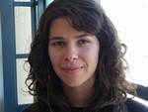
Testimonials to Student Learning
“Co-creating “Empowering the Yard” has made a lasting impact in my life. With 1 in 100 Americans incarcerated and the growing rate of HIV/AIDS among young women, it is imperative that we listen and learn from one another…
Since the film's initial screening at SFSU in May 2008, Empowering the Yard has been entered and accepted to film festivals across the country and is going global.”
Emily Kirsch
Notes:
We will start with the testimonial of this student, Emily Kirsch, who helped produce the documentary “Empowering the Yard” about incarcerated women with HIV in Oklahoma. She writes:

Slide 28
Social Justice Documentaries
Empowering the Yard
Video available at:
http://www.aidsfund.org/naf/video/play.cfm?video=Empowering.flv
Presented by the San Francisco State University Health Equity Initiative and the National AIDS Fund in partnership with the SF State Health Education and Cinema Departments.
Notes:
I’m going to show the first 2 minutes of the documentary she helped produce: Empowering the Yard. Set in Oklahoma where more women are incarcerated per capita than anywhere else in the world, Empowering the Yard looks at HIV prevention from the perspective of incarcerated women who are using peer education to empower themselves, their families, and their communities

Slide 30
Testimonials to Student Learning
Behind the Scenes
Video available at:
http://www.aidsfund.org/naf/video/play.cfm?video=Behindthescenes.flv
Presented by the San Francisco State University Health Equity Initiative and the National AIDS Fund in partnership with the SF State Health Education and Cinema Departments.
Notes:
A critical element in ePortfolios is the opportunity for students to reflect upon their learning. This 5 minute video documents the learning experience for not only the students, but also the instructors and administrators who were involved in this project.

Slide 32
Mapping Artifacts to Institutional Goals
Video
Reflection
Texts & Resources
Notes:
As we review the learning outcomes presented earlier, individuals viewing this ePortfolio, whether they be faculty, administrators, members of accrediting bodies, or future employers, can clearly assess that the students engaged in this course have achieved all the spectrum of learning outcomes with respect to Social Justice.

Slide 33
Thank You.
Maggie Beers, Ph.D. Director, Academic Technology
Linda Buckley, Ph.D. Associate Vice President, Assessment & Planning
Gail G. Evans, Ph.D. Dean, Undergraduate Studies
ePortfolio Day of Dialogue
San Francisco, CA
February 25, 2009

Slide 34
Discussion
In groups, please discuss and report back:
How can you incorporate the LEAP Essential Learning Outcomes at your university for:
Strategic Planning
Curriculum Design
ePortfolio Assessment

